Slide 1


DEWU
AI Analysis of the value of the Try Makeup/ Shoe features in DEWU
Reporter：Cecilia、Judy
Time：2025/11/04
////
AI Analysis of the value of the Try Makeup/ Shoe features in DEWU
////

Slide 2


01
Market Background
////
AI Analysis of the value of the Try Makeup/ Shoe features in DEWU
////

Slide 3
The Core Pain Point of Online Consumption
User pain points:
· Lack of fitting experience
· Unclear makeup effect
· High return risk and decision-making cost
Industry impact:
Low conversion rate, difficult to increase the unit price of customers, high return rate, seriously restrict the online consumption experience.
////
AI Analysis of the value of the Try Makeup/ Shoe features in DEWU
////

Slide 4

02
Function Analysis
////
AI Analysis of the value of the Try Makeup/ Shoe features in DEWU
////

Slide 5
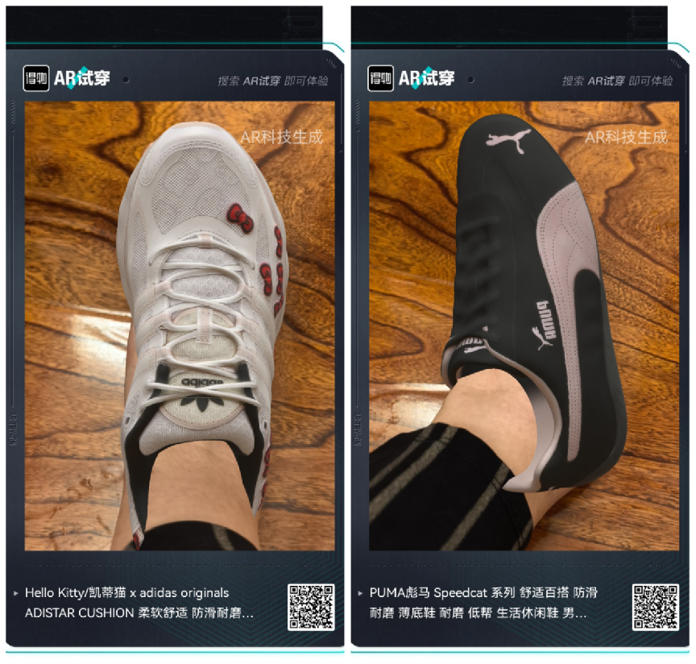
AI Shoe Fit
The mobile phone camera accurately captures the foot and scene, and realizes the virtual shoe on the foot.
Supports 360-degree view to simulate real-wear effect and gait.
Covering a huge number of trendy shoes, it meets the core needs of young users to "show off their outfits".
////
AI Analysis of the value of the Try Makeup/ Shoe features in DEWU
////

Slide 6
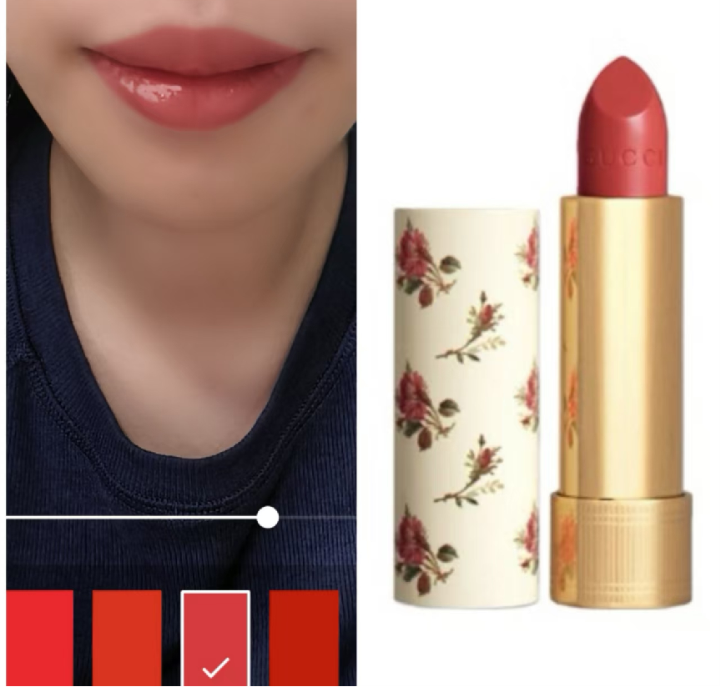
AI Makeup
Intelligent face recognition to achieve high-precision makeup product color test.
Includes all categories such as lipstick, eyeshadow, and foundation, and allows you to switch between different brands and colors with one click.
Realistic effect, solve color difference and adaptation problems.
////
AI Analysis of the value of the Try Makeup/ Shoe features in DEWU
////

Slide 7
03
Data Insights
////
AI Analysis of the value of the Try Makeup/ Shoe features in DEWU
////

Slide 8
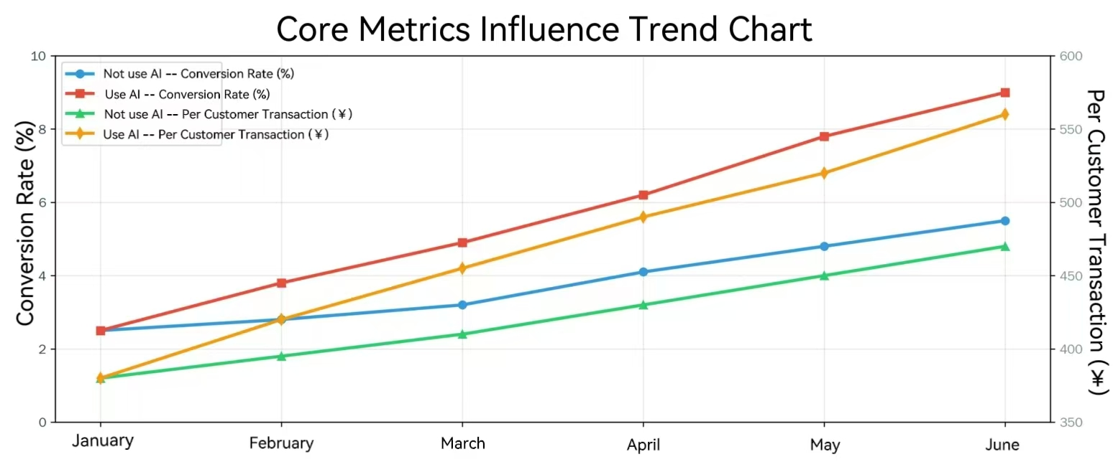
Significantly improve conversion rates
Effectively increase the average order value
////
AI Analysis of the value of the Try Makeup/ Shoe features in DEWU
////

Slide 9
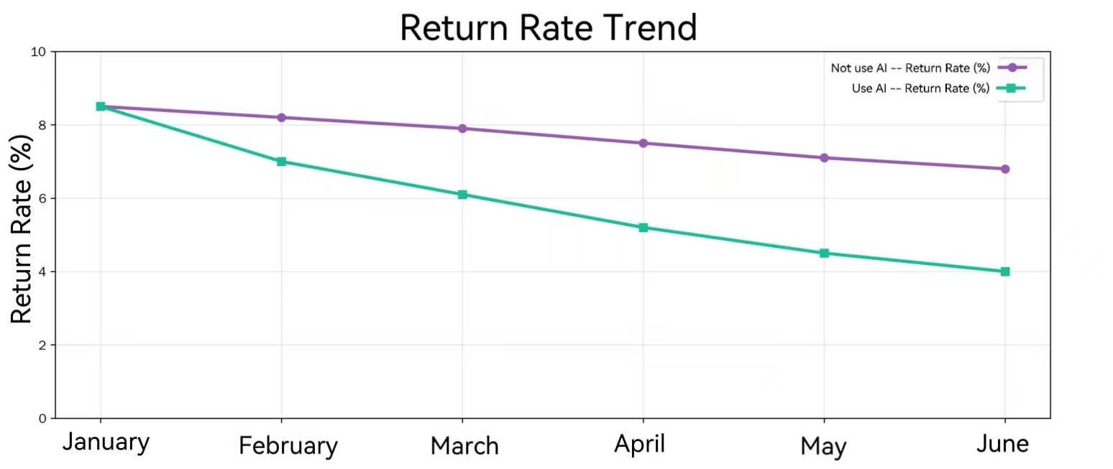
The return rate has decreased significantly
////
AI Analysis of the value of the Try Makeup/ Shoe features in DEWU
////

Slide 10
04
User Behavior And Long-term Value
////
AI Analysis of the value of the Try Makeup/ Shoe features in DEWU
////

Slide 11
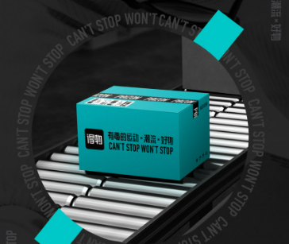
Build User Engagement And Brand Barriers
01
Extend user dwell time
02
Boosting social engagement
03
Building a technological moat
////
AI Analysis of the value of the Try Makeup/ Shoe features in DEWU
////

Slide 12
05
Conclusion
////
AI Analysis of the value of the Try Makeup/ Shoe features in DEWU
////

Slide 13
Conclusion
01
AI makeup and shoe fitting features are the core drivers of business growth.
By improving conversion, increasing customer order and reducing returns, it directly optimizes the core financial indicators of e-commerce
02
03
It is a key differentiating competitive means to build brand, enhance stickiness and lead the industry.
////
AI Analysis of the value of the Try Makeup/ Shoe features in DEWU
////

Slide 14
DEWU
AI Analysis of the value of the Try Makeup/ Shoe features in DEWU
Reporter：Cecilia、Judy
Time：2025/11/04
////
AI Analysis of the value of the Try Makeup/ Shoe features in DEWU
////

